Slide 1
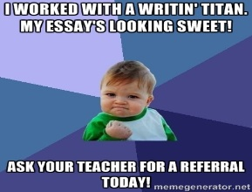
“Student-led Writing Centers:
Addressing the Common Core
and Promoting Better Writing”
By
Emma Betts
Hannah Cobbley
Alonna Crispin
Brett Endress
Garrett Forrest
Mya Gramm
Sami Harlan
Allison Kelly
Sophia Lowery
Rich Martin
Ashlyn Mool
Kameryn Raymer
Nash Stoller
Notes:
Presentation introduced by Mr. Martin. Everyone is introduced.

Slide 2
What is a Student-led
Writing Center?
Nancy Grimm identifies three common objectives writing centers share:
1) A good tutor makes the student do all the work.
2) The ultimate aim of a tutorial is an independent writer.
3) Our job is to produce better writers, not better writing. (McKinney 60)
Rich Kent— “Writing centers... are places where writers talk with fellow writers about their work in an effort to discover a thesis, overcome procrastination, develop ideas, create an outline, evaluate a draft, or revise a draft. Writing center staff members support, tutor, and confer with writers in an effort to encourage and motivate.” (Kent 2)
Notes:
Mr. Martin: Most colleges feature a writing center, where students can come to meet with trained tutors. Several high schools host writing centers, particularly in suburban Chicago. There are only a handful of junior highs that have a writing center where students serve as the tutors. The Writin’ Titan program is the first in a network we’re working to create as part of the Illinois State Writing Project.

Slide 3
The Writin’ Titan Program
of El Paso-Gridley Junior High
The Writin’ Titan Program was established in September 2013. Since that time, our peer tutors (Writin’ Titan Coaches) have conducted over 1,000 sessions with grade school and junior high students. In addition, our coaches have been utilized in assisting Special Ed and ESL students.
Our Mission:
To help students become more capable, knowledgeable writers through collaboration
To not just assist writers with the task at hand, but to share and practice skills with writers they’ll find helpful in the future (“Give a man a fish and he eats for a day. Teach a man to fish and he eats for life”).
Notes:
Brett: Reads slide.
Allison: Adds, “Again, this is one of our main principles, to not just help the student with their paper, but to impart good writing practices so that our clients become more skilled writers. For example, if a client has a bad introduction that needs revising, we don’t just help them rework the intro, we actually teach them about possible introduction strategies they can use in the future.”

Slide 4
How It Works
1st—
--A student who wants help with a writing assignment requests a pass from their teacher to come see us.
OR
--A teacher gives a struggling student a pass.
2nd—
--The coach helps the student over study hall or lunch.
3rd—
--The coach records the coaching session in the logbook and reports back to the teacher on the progress that was made.
https://www.youtube.com/watch?v=zMLCcMdOV-c&feature=youtu.be
Notes:
Emma: Reads slide
Nash: Also, We’ll be showing you a short commercial we produced this year. This video was shown to all junior high students in their language arts classes to demonstrate how our writing center works.

Slide 5
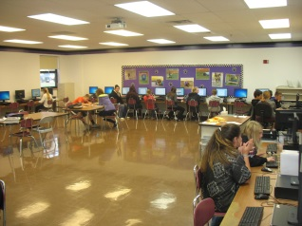
Our Guiding Principles
Any Student, Any Stage in the
Writing Process
We battle the common stigma of “the writing center is just for struggling writers.” This is for smart writers actually, because a good writer realizes that everyone can use help.
We’re so much more than a “proofreading service.”
The Student Does All the Work
Coaches support, assist, and encourage writers,
but do not actually write (unless modeling).
We use a non-directive approach.
Notes:
Garrett: Reads Point #1
Garrett: Adds, “Concerning the first bullet point, we actually consult with one another on our work because, as coaches, we know first-hand the value of talking about our writing with others. In addition to proofreading, we help classmates come up with topics, brainstorm, research, and outline. We’ll even help kids with tech-related issues. We’ll also serve as an audience for classmates preparing a presentation.”
Kameryn: Reads Point #2
Kameryn: Adds “Non-directive means that, as much as possible, we don’t tell our classmates what to do. We try to ask questions that guide them to think about their writing. For example, instead of saying, ‘Put a period here,’ we might ask, ‘What’s this sentence missing?’ This way, students think through their own writing issues.”

Slide 6
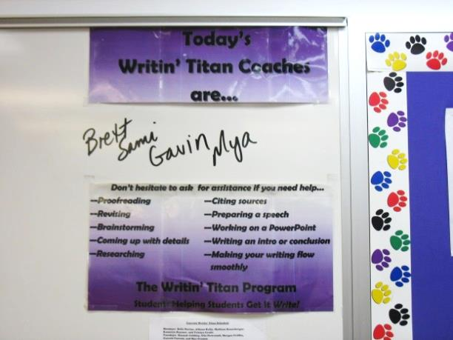
Our Guiding Principles
Transparency to Teachers,
Confidentiality for Students
Teachers receive a “session summary” following the consultation so they have an accurate account of what their students accomplished.
Students should feel safe that what happens during a coaching session stays private.
Better Writers, Not Just Better Papers
If students and tutors only focus on earning an A on the assignment at hand, they’re missing out on a valuable learning opportunity. Coaches should pass along what they know about good writing.
Notes:
Sami: Reads Point #3
Sami: Adds, “It’s really important that teachers get a sense of what their students accomplished during a coaching session. That way, they can see how the session helped their student and whether it was worthwhile. The teacher will also know where to pick up with the student, or whether to write another pass. We’re kind of like teachers’ minions. What a teacher can’t get to, in terms of one-to-one writing help, we can.”
Others: Hand out copies of “session summary.”
Mya: Reads Point #4
Mya: We get reminded over and over by Mr. Martin that as we tutor, we should be teaching, not just correcting.

Slide 7
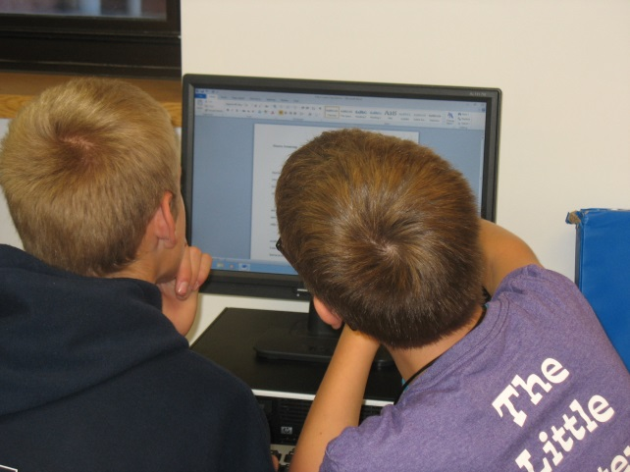
Our Guiding Principles
Training,
Training,
Training!
Notes:
Alonna: Reads slide
Alonna: During our first quarter training, we cover lots of topics. For example, we discuss how to help classmates brainstorm. We also talk about how to address higher-order concerns like organization and staying on topic before we address lower-order concerns, like grammar and punctuation. As Mr. Martin tells us, don’t wax the car if the engine won’t even run. We practice how to be good listeners and how to play “devil’s advocate” without being mean. We also practice proofreading strategies, like having classmates read their work aloud to find their own errors.
Hannah: We also talk about how to handle sticky situations, like when we think a classmate is plagiarizing. On one hand, we don’t want to rat on the student, but on the other hand, students need to know that copy and paste won’t work. So, we give them tips on avoiding plagiarism, like how to properly cite sources. Also, we’ve been instructed to tell any copy/pasters that we won’t tell on them, but that’s because we won’t have too. The teacher will easily spot it.
Ashlyn: During training, we create a coach’s binder. In it, there are, for example, different introduction and conclusion strategies, a list of transitions, sample outlining sheet, and basic coaching procedures. We keep our binders on hand while coaching in case we need them. We’ll pass it around so you can take a look.
Coaches: Anything else we’ve learned from training?

Slide 8
Writing Centers: Tailor-made to
Address the Common Core
Common Core Writing Anchor Standard 5:
CCSS.ELA-LITERACY.W.8.5 With some guidance and support from peers and adults, develop and strengthen writing as needed by planning, revising, editing, rewriting, or trying a new approach, focusing on how well purpose and audience have been addressed.
Notes:
Mr. Martin: The key phrase here that relates to student-led writing centers is “guidance and support from peers.” So, the standards encourage that students work with one another during the writing process. This is a smart practice in general, for any writer. Even professional writers have editors.
Teachers often incorporate this standard into their classrooms through the use of a “peer edit” activity. This can be problematic, because students really need training to be an effective peer editor. Often, a peer edit leads to unhelpful comments, such as “good job.” In the context of a student-led writing center, you have students trained to help their classmates “plan, revise, edit, rewrite, try a new approach, and focus on audience and purpose.”

Slide 9
The Need for Writing Support across the Curriculum:
The ELA Appendices
There is a clear expectation that sophisticated argument, informational/explanatory, and narrative writing be incorporated in the teaching of history, science, and technical subjects.
Example: Included in the Common Core website’s appendix of sample student writing is a 7th grade science report that is over 2,000 words in length and incorporates fourteen sources, original research, and multiple illustrations. (Appendix C 42).
http://www.corestandards.org/assets/Appendix_C.pdf
Notes:
Mr. Martin: For example, let’s look at ELA Appendix C [click on link]. What you see here is an model 7th grade science essay. This is a complex piece of writing that, honestly, many high schoolers may not be able to pull off. This paper incorporates 14 sources and multiple illustrations. This would require extensive research, knowledge of correct citation, and multiple drafts to accomplish. Few science teachers would want to devote the class time necessary to discuss how to put together such an elaborate piece of writing; they’ve got other things to teach. This is where a student-led writing center can come in handy. It can serve as a resource for students who need extra guidance, and it takes some of the work off non-English teachers’ plates. With a writing center, this type of essay becomes more feasible.

Slide 10
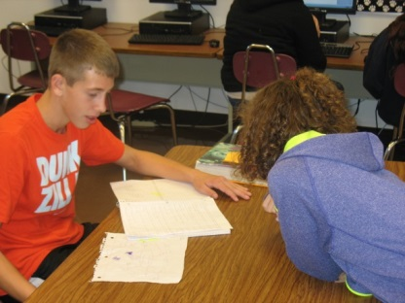
In Addition to Addressing
Common Core...
Support for Students
Collaboration and conversation are key
elements of the writing process.
It provides opportunities to test ideas and expression on a peer.
It’s an informal, fun resource for any stage in the writing process.
Support for Teachers
It’s difficult to get to every student.
Teachers outside of English may feel less comfortable teaching the “nuts and bolts.”
Notes:
Sophia: Reads Point #1
Mr. Martin: Adds, “Collaboration is often the forgotten element in the writing process of students. However, it’s real-world life skill. When adults craft pieces of writing at their work, it often involves the input of co-workers. It really just makes sense for students to start to develop in school the habit of having others help them sharpen their writing.”
Ashlyn: Reads Point #2
Mr. Martin: Adds, “by ‘nuts and bolts,’ we’re referring to issues like grammar, punctuation, and standard conventions. A social studies teacher, for example, may not want to take the class time to discuss how to properly incorporate quotations. They could, instead, give writing center referrals to the students who need it. Also, teachers often deal with over 100 students daily. To keep up with the writing of each student is
impossible. So, if a teacher knows a kid is struggling, but doesn’t have the time to get to them, they can hand out a writing center referral.”

Slide 11
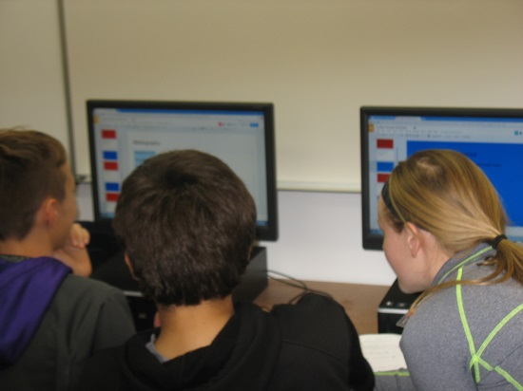
In Addition to Addressing
Common Core...
Support for Differentiated Instruction
It can support struggling writers and provide
enrichment for more advanced writers.
Support a School-wide Writing
Environment
It promotes an appreciation for the value of writing
across the subjects and among all students and staff.
Teachers are reminded and encouraged to
incorporate writing in their classrooms.
Students are more conscientious about reviewing
their writing.
Notes:
Sophia: Reads Point #3
Mr. Martin: Adds, “It’s difficult for teachers to challenge each individual student at their own level of skill and knowledge. At least in writing, this is one way to build in differentiation. It’s Response-to-Intervention with writing, in a way. Writers at a lower skill level can receive extra instruction and one-on-one time from a peer tutor to help them improve, and writers at a higher skill level get to practice and pass on their knowledge. As the saying goes, to really learn something, you must teach it. This is true for peer tutors.”
Ashlyn Reads Point #4
Mr. Martin: Adds, “At our junior high, we’ve seen the amount of writing that students are assigned increase, in part because teachers are reminded just by the presence of our writing center to try to incorporate writing into their instruction. In terms of students, we’ve seen our number of consultations increase, because more and more students are finding out that working with a Writin’ Titan coach is helpful.”

Slide 12
Lessons Learned
Educate your staff and students as to what the purpose of your writing center is and how it works. Provide ten times the information you think should be sufficient.
Advertise, Advertise, Advertise (advertise).
3. Train your coaches in tutoring basics and writing
center principles, but also prepare them to be
flexible in their methods.
Be prepared to combat common misperceptions and concerns.
Be patient--it may take a while for students and
teachers to buy into the idea of a writing center.
Notes:
Presented by Mr. Martin

Slide 13
Coaches Experiences
As coaches, we probably gain more than anyone from our writing center. Here’s what we’ve learned...
Notes:
Brett: Reads slide
Coaches: 5 or 6 students talk about what they’ve learned from (or gained from) tutoring.

Slide 14
Resources to Help You Create a Writing Center at Your School www.writintitans.weebly.com http://ilstatewp.com/creating-a-writing-center-network/
Notes:
Mr. Martin shows off website.

Slide 15
Q & A --Questions for our Writin’ Titan coaches? --Questions for Rich?
Notes:
Brett: “Thanks for listening to our presentation. Does anyone have questions about the Writin’ Titan Program or writing centers in general?”

Slide 16
Works Cited
“Appendix C: Samples of Student Writing—Common Core State Standards for English Language Arts & Literacy in History/Social Studies, Science, and Technical Subjects.”Common Core State Standards Initiative. 2012. Web. 7 Feb. 2014.
Kent, Richard. A Guide to Creating Student-Staffed Writing Centers:
Grades 6-12. New York: Peter Lang, 2006. Print.
McKinney, Jackie Grutsch. Peripheral Visions for Writing Centers. Logan, UT: Utah State, 2013. Print.
Suggested Readings:
Farrell, Pamela B. The High School Writing Center: Establishing and
Maintaining One. Urbana, IL; NCTE, 1989. Print.
Fels, Dawn and Jennifer Wells. The Successful High School Writing Center:
Building the Best Program for Your School. New York: Teacher’s College, 2011. Print.
Notes:
Mr. Martin

Slide 17
Contact—
Rich Martin—
martinr@unit11.org
Notes:
Mr. Martin concludes.
Emma: And for coming to our presentation, we have a little gift for each of you. These are pencils we give out to students who use our service.
Everyone: Pass out pencils

