Slide 1
Poster #1
How about taking that essay from jank to dank, bro?
Consult with a Writin’ Titan coach today!

Slide 2
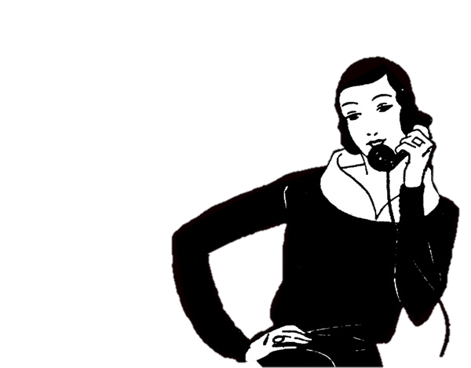
Poster #2
Yes, Tommy. I was confuzzled about the essay also. But thanks to the Writin’ Titans, my essay is on fleek!
Get a pass to work with a Writin’ Titan. They’re totes legit, bae!

Slide 3
Poster #3
I heard you turned in a gucci essay after working with a Writin’ Titan.
Savage!

Slide 4
Poster #4
My homeboys informed me that Writin’ Titan coaches could help me with my presentation.
They most certainly did! *drops mic*

Slide 5
Poster #5
Haters said my essay was trash. But my essay is now swag, like me.
How? The Writin’ Titans, my peeps. What now, haters?

Slide 6
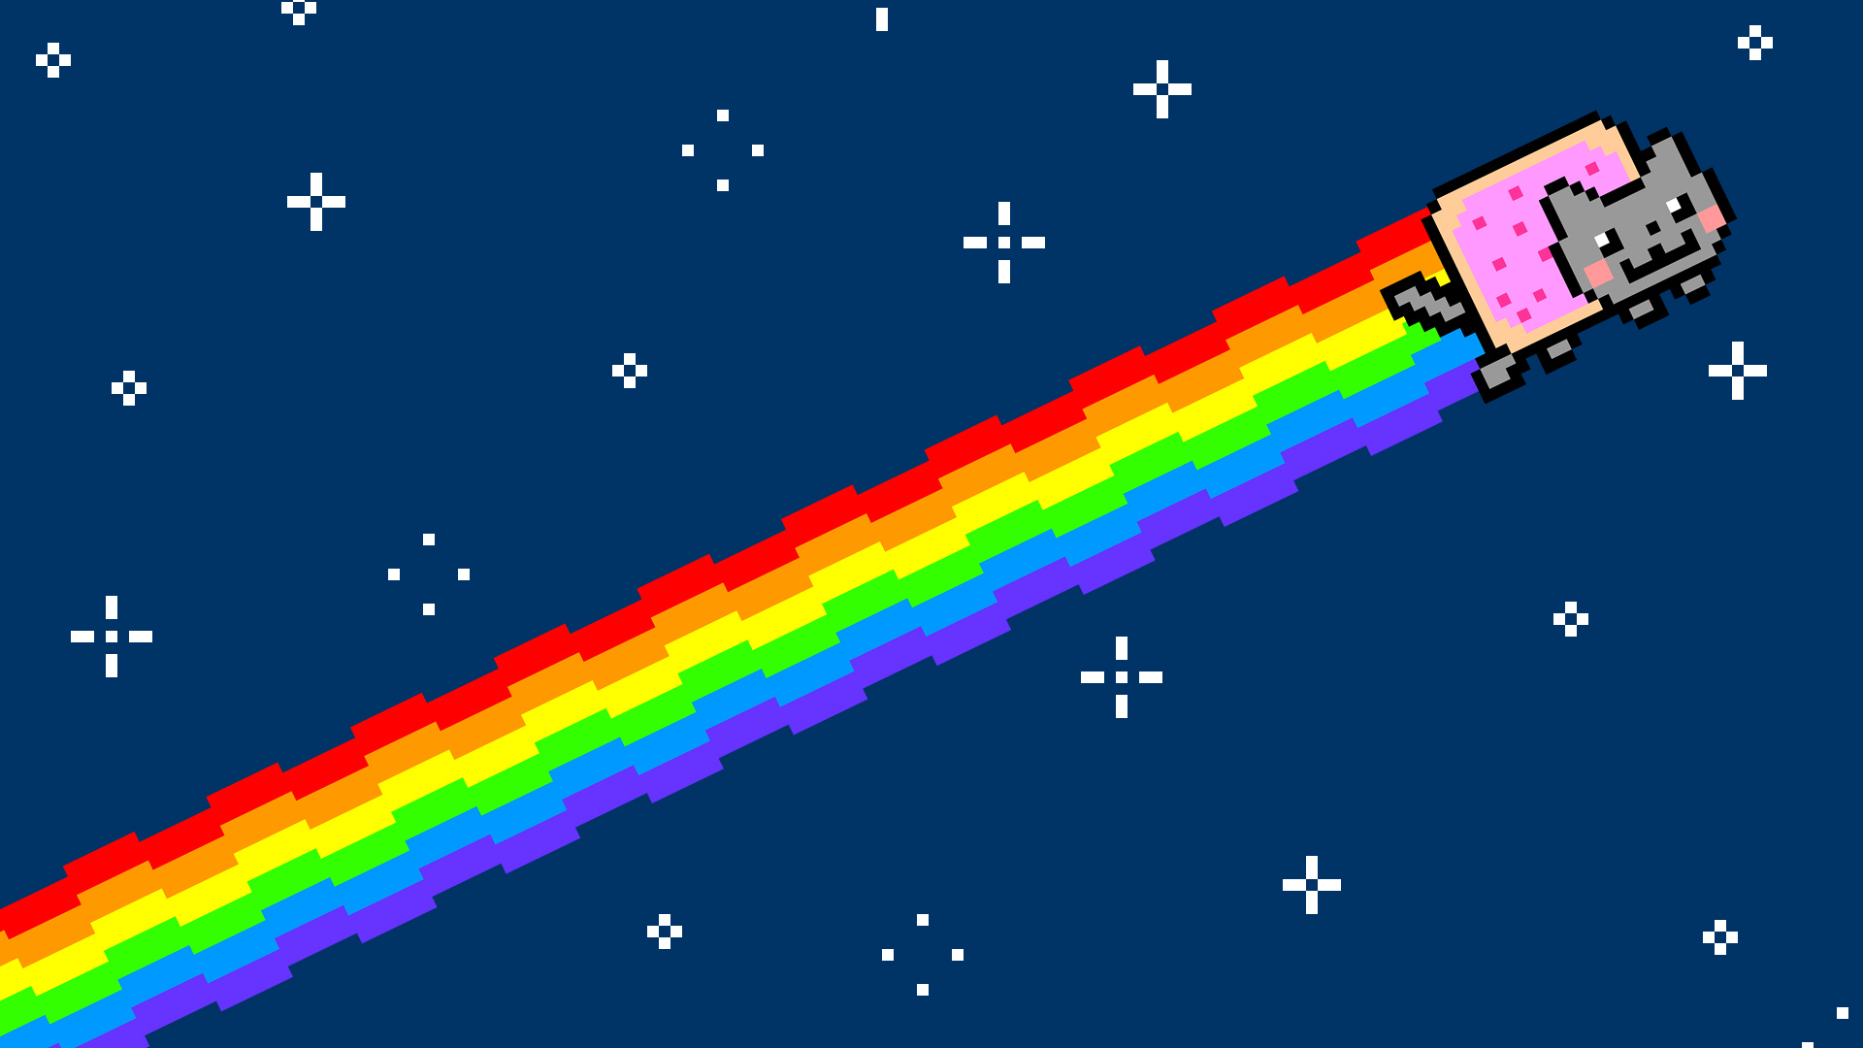
Poster #6
Nyan Cat for the
Writin’ Titan Program:
“Meow.”
We’re students helping students get it “write,” since 2013.

