Slide 1
The Writin’ Titan Program
Student’s Helping Students
Get It Write

Slide 2
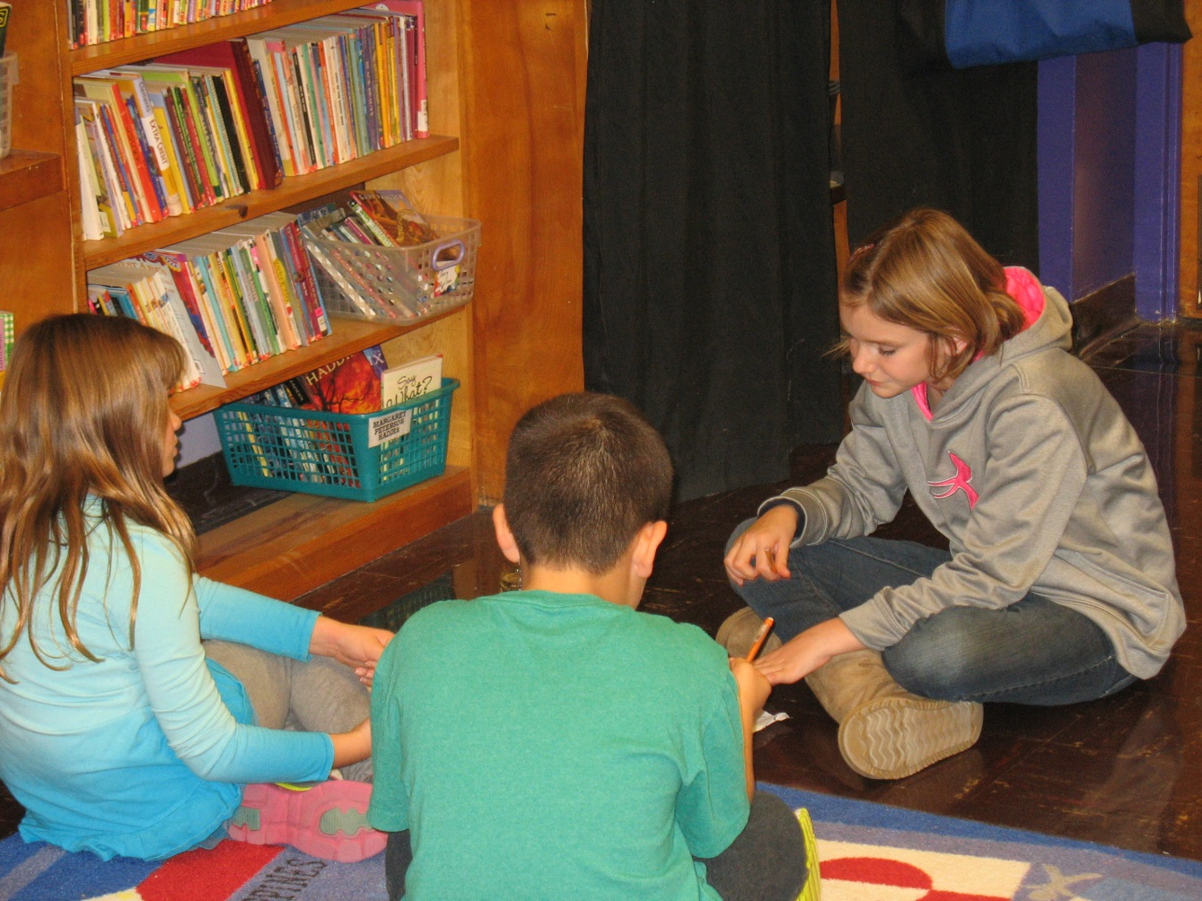
Our Mission
To help students become more capable, knowledgeable writers through collaboration
Our goal is not just to assist writers with the task at hand, but to share and practice skills with writers they’ll find helpful in the future.
(“Give a man a fish/Teach a man to fish”)
Notes:
Paige:
Second Bullet—Give a man a fish, he eats for a day. Teach a man to fish, he eats for a lifetime. We’re working to help classmates over the long term, not just on the paper they’re currently working on.

Slide 3
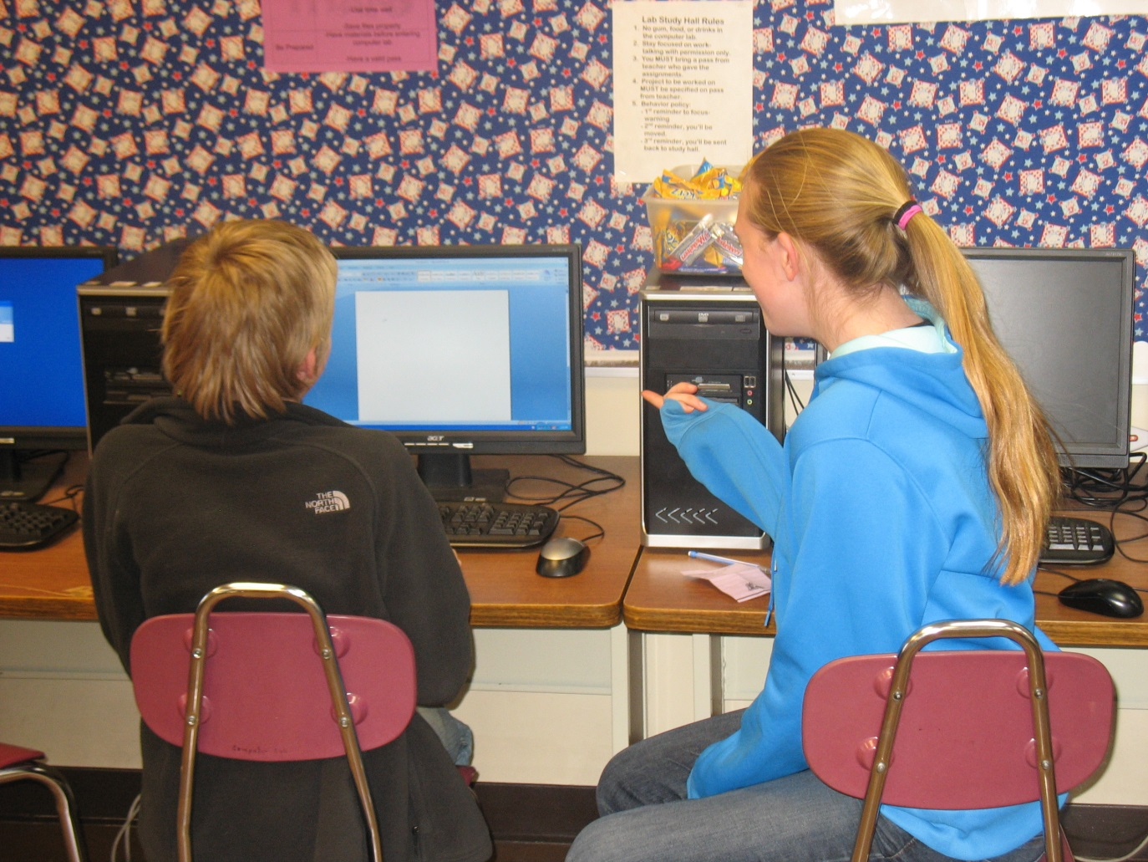
Why The Writin’ Titan Program?
Helps students of all skill levels with writing-related tasks
Brainstorming, Outlining, Researching, Composing, Revising, Editing...
An intervention for struggling students
Collaboration can lead to better learning and is a life skill
A resource for teachers looking to assign writing
An innovative program our school can proudly tout
Notes:
Grace:
First Bullet—This is not just for students that struggle with writing. This is for everyone. Even the strongest writer can benefit from having another person to bounce ideas off of and look over their work. We’ve focused on fighting the stigma that “only dumb kids need this.” We say, actually, that only smart kids use this, because if you’re smart, you know that it’s always a good idea to have someone else look over your work.
Third Bullet—In other words, two brains are better than one.
Fourth Bullet—Writing is difficult to teach and difficult to grade. It’s not always possible for a teacher to get to every student who could use individual attention.
Fifth Bullet—Our junior high is one of only a handful in the nation that have a program like this.

Slide 4
Why The Writin’ Titan Program?
Addresses Common Core Writing Anchor Standard 5:
CCSS.ELA-LITERACY.W.8.5 With some guidance and support from peers and adults, develop and strengthen writing as needed by planning, revising, editing, rewriting, or trying a new approach, focusing on how well purpose and audience have been addressed. (Editing for conventions should demonstrate command of Language standards 1-3 up to and including grade 8 here.)

Slide 5
Why The Writin’ Titan Program?
Addresses Common Core Speaking and Listening Anchor Standard 1:
CCSS.ELA-LITERACY.CCRA.SL.1 Prepare for and participate effectively in a range of conversations and collaborations with diverse partners, building on others' ideas and expressing their own clearly and persuasively.

Slide 6
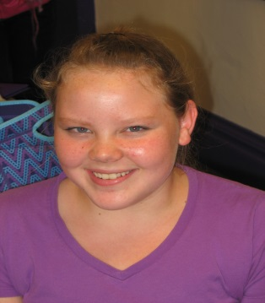
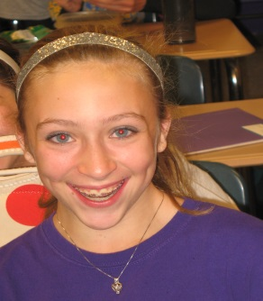
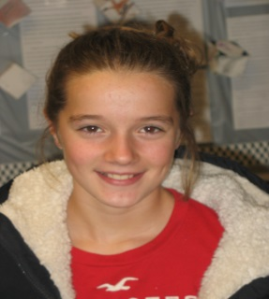
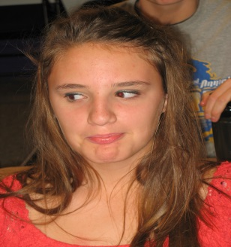
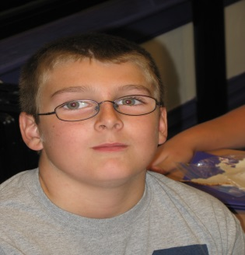
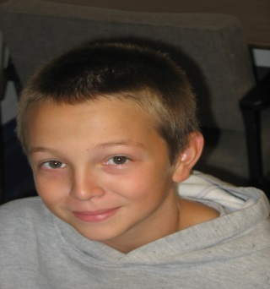
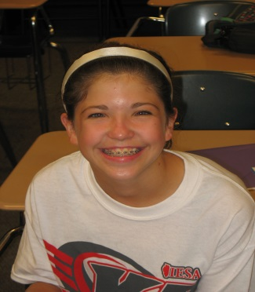
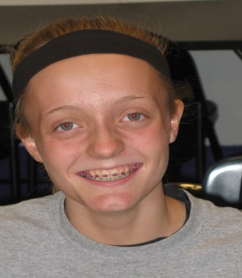
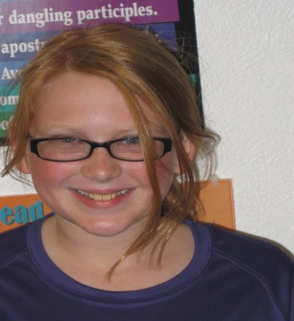
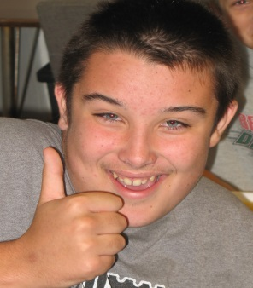
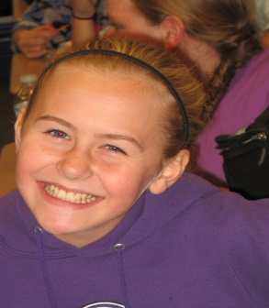
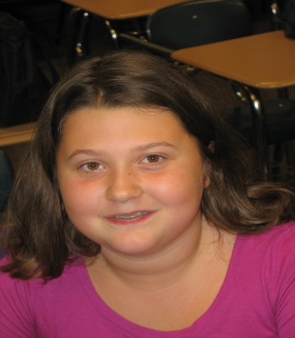
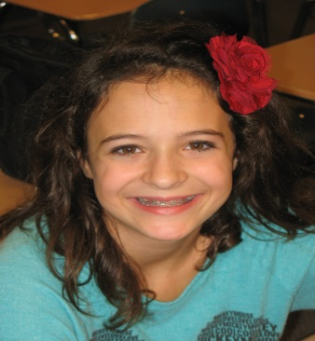
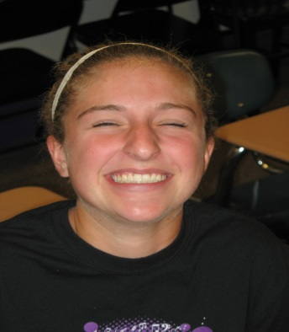
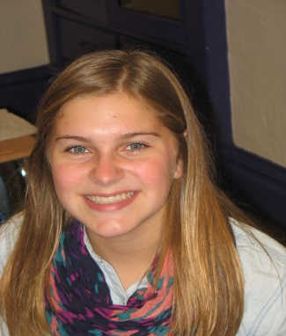
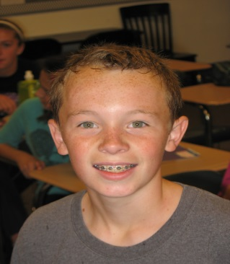
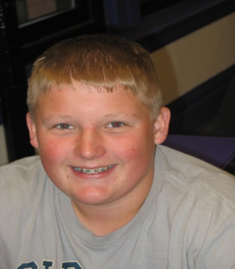
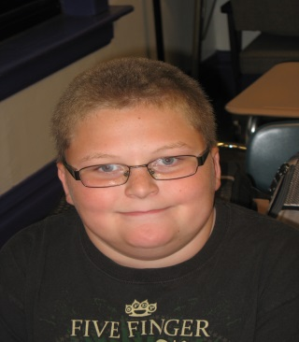
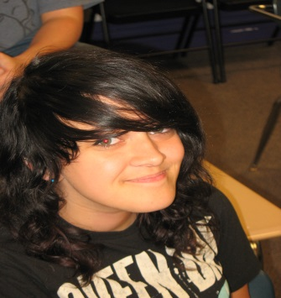
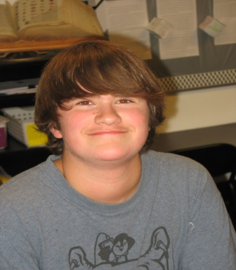
Writin’ Titan Coaches
22 seventh and eighth graders
Recommended by teachers as being strong writers, responsible, and friendly
Received training over first quarter, meeting two times a week over lunch
Worked through how to build a good rapport with writers and how to help them with the various stages of the writing process
Notes:
Corbin:
Say, “We’re called ‘coaches’ because, like a coach, we’re on the sidelines providing advice and strategies. We’re not on the court or field, so to speak, doing the writing. The writer does the writing. We’re just there to provide support.
After this slide is read, each of you should say one thing you remember from training.

Slide 7
How It Works
1st—
--A student who wants help with a writing assignment requests a referral from their teacher
OR
--A teacher gives a struggling student a referral.
2nd—
--The coach helps the student over study hall or lunch.
3rd—
--The coach records the coaching session in logbook and reports back to the teacher on the progress that was made.
http://youtu.be/bNWa2IcWi4g
Notes:
Paige reads:
Corbin and Grace pass out referrals to the audience for them to see.

Slide 8
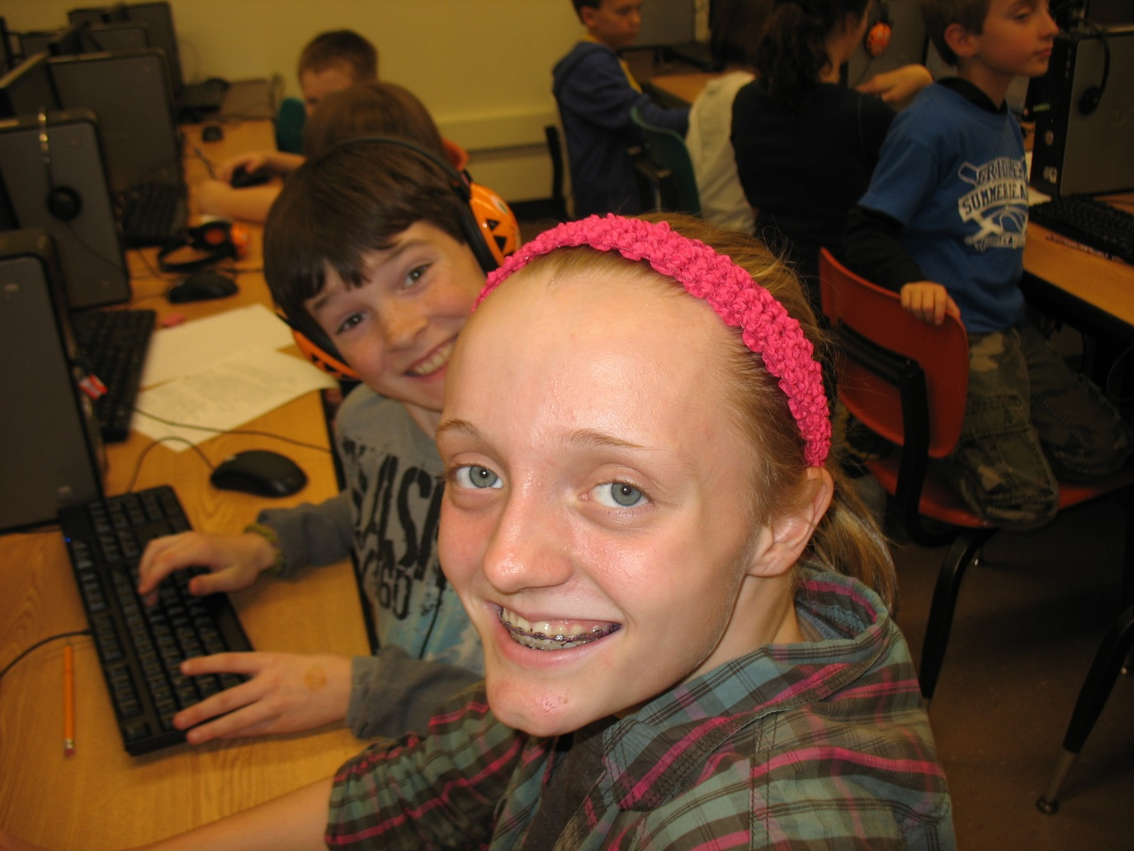
Coaching Guidelines
Here’s What We Do:
1. We help writers at any stage of the
writing process.
2. We work to improve classmates’
writing skills.
3. We keep coaching sessions private.
We treat our clients with respect and
kindness.
Notes:
Corbin:
... Whether they haven’t even figured out a topic, or they are in the final stages and just need proofreading help.
... Students can rest assured that only the coach, the student, the teacher will know about a coaching session. We keep things confidential.

Slide 9
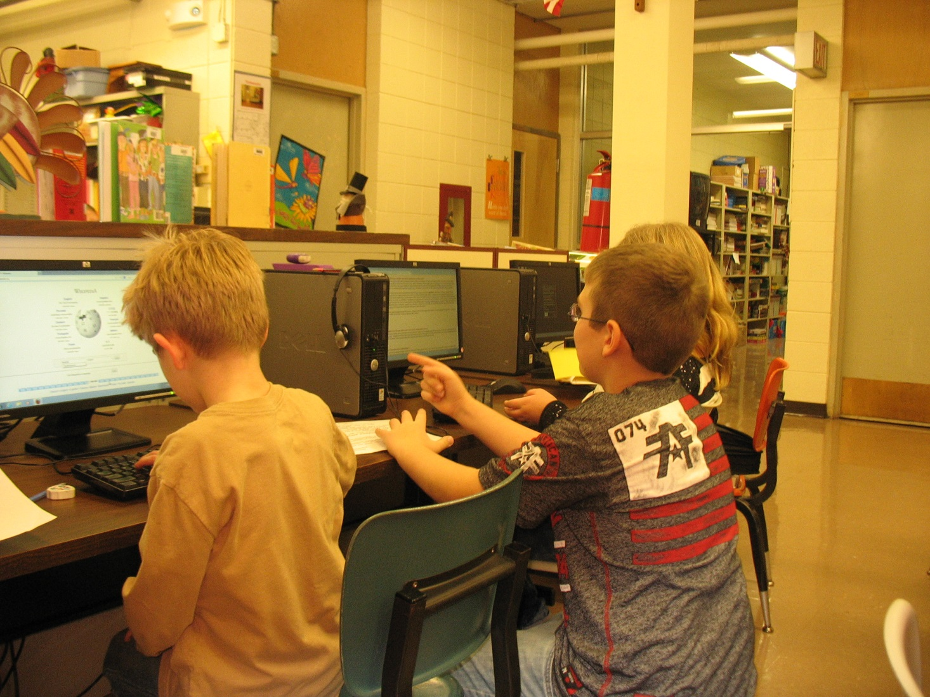
Coaching Guidelines
What We Don’t Do:
We don’t write or fix students’ papers for them.
We don’t put down teachers
or their assignments.
3. We don’t guarantee A’s.
Notes:
Grace:
If possible, we don’t even touch the keyboard (if they’re typing) or the paper (if they’re writing by hand). This is the thing we stress the most; we don’t do the writing. We’re just on the sidelines. It’s vital to our reputation that students and teachers know this.
3. We also tells classmates we work with that we’ll do the most we can with the time we have. Often, that’s not enough time to get an entire paper polished.

Slide 10
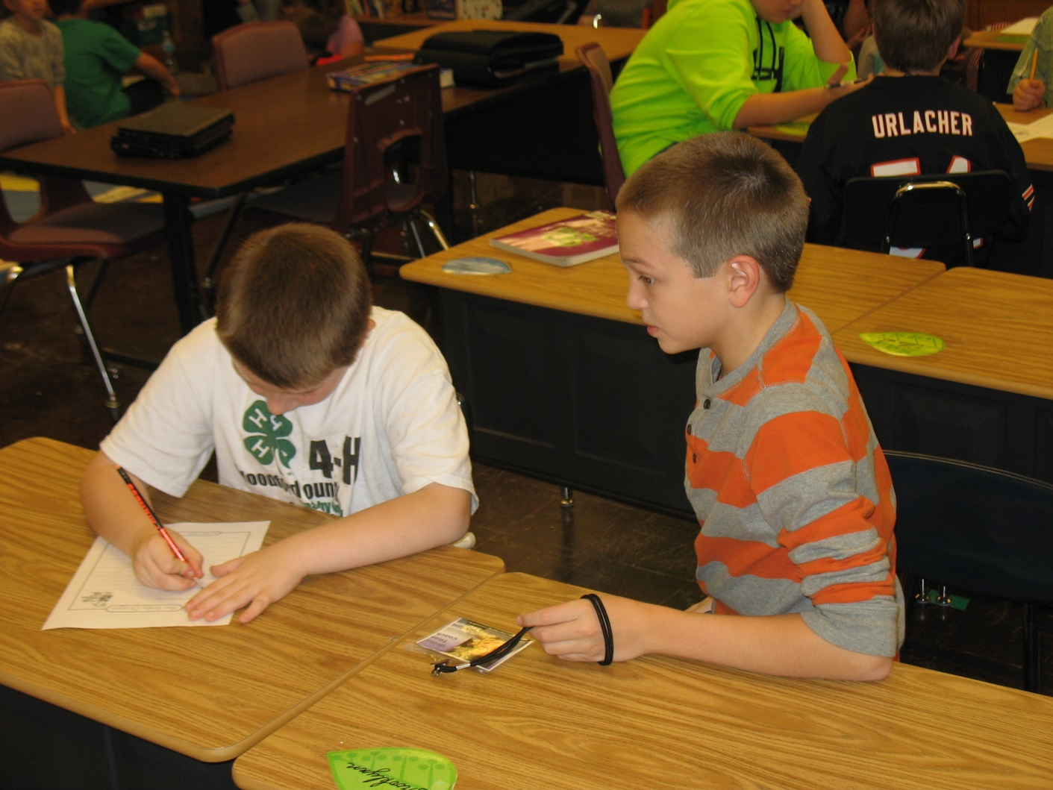
How’s It Going?
Since beginning in mid-October, coaches have conducted approximately 240 coaching sessions with 6th , 7th, and 8th grade students.
Coaches have conducted approximately 70 sessions with Mr. Watson’s 3rd graders over the course of 4 separate projects.
Feedback from students and teachers has been positive.
Notes:
Paige reads...
After she reads this slide, I’ll ask each of you to share something positive about your experience as a Writin’ Titan Coach.

Slide 11
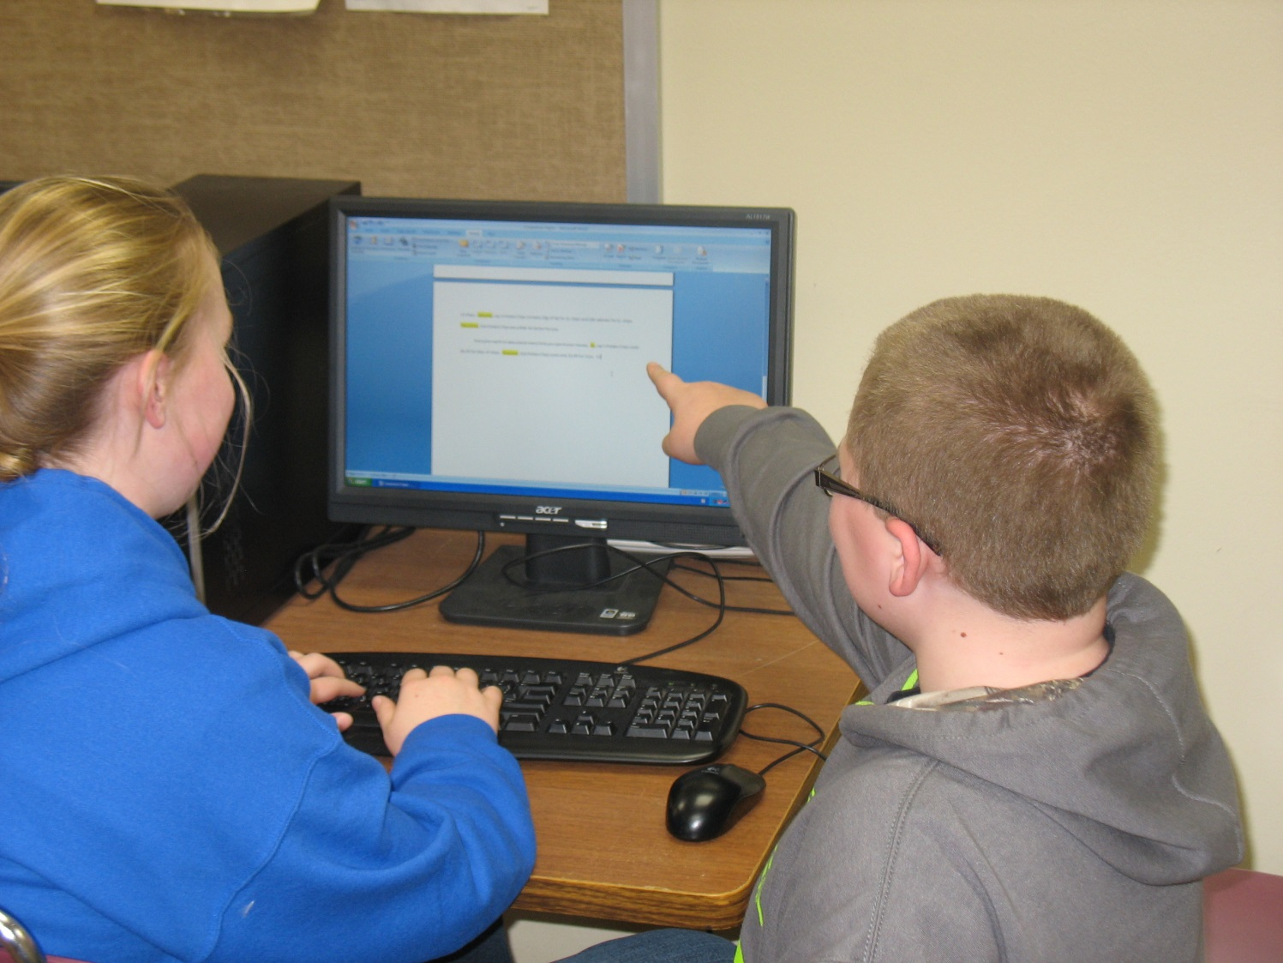
The Future of The Writin’ Titan Program
Continue the program to promote a culture of writing and collaboration at the junior high
Possible $4,500 grant through ISU and the National Writing Project aimed at helping teachers use the WTP
Presentation at 2014 IATE conference
Continue as the first in a network of local writing centers
Notes:
Mr. Martin reads.

Slide 12
Lessons Learned after Year One...
1. Educate your staff and students as to what the purpose of your writing center is and how it works. Provide ten times the information you think should be sufficient.
Nobody seems to get what writing centers are (and are not), especially teachers.
Teachers don’t read half of the information you’ll send their way.
The WC was a completely foreign idea to my students. It took quite a while for them to catch on and learn to use it as a resource.

Slide 13
2. Advertise, Advertise, Advertise (advertise).
At the risk of garnering your colleagues’ resentment, you’ve must routinely be in their ear reminding them about the WC.
Ask colleagues what writing projects they currently have or will have going on in their classes.
Strategies the Writin’ Titans used:
--T-shirts for coaches --Skit during school assembly
--Posters in hallways --Promotional materials
--YouTube video shown by (pencils)
English teachers --In-class reminders
--Flyers handed out and discussed --School board presentation
with all students --Article in local newspaper
--Articles on school website --Referrals furnished by coaches
--Occasional e-mail reminders
to staff of our services
James Upton: “Simply making the services available to students and staff is not enough; we also have to create the need for the center” (80).

Slide 14
Train your coaches in tutoring basics and writing
center principles, but also prepare them to be flexible in their methods.
I began by teaching my coaches to use a somewhat
rigid procedure in tutoring classmates... it didn’t work.
I taught my coaches various WC maxims, such as “Don’t
touch writer’s keyboard/paper” and “Ask leading questions rather than providing answers.” This can stifle coaches’ ability to help. classmates. I’d certainly stifle my ability to help students. Different students require different strategies.
As a look at training students for year two, I think I’ll
focus less on procedures and more on developing a repertoire of available strategies.

Slide 15
4. Be prepared to combat the following misperceptions and concerns:
From Students:
The WC is only for “dumb” kids
The WC will write my paper for me
The WC will completely fix my paper
The WC is great for getting out of study hall to goof off
From Teachers:
The WC will turn into “the blind leading the blind”
We’ll basically be authorizing cheating
We should have a resource for all subjects. What makes writing so special?
If we’re using the WC to address Common Core W5, shouldn’t peer editing/tutoring be a classroom activity?
From Both:
The WC is solely for proofreading purposes
The WC is a “prison,” “hospital,” or “service station”

Slide 16
Be patient--it may take a while for students and
teachers to buy into the idea of a WC.
We only had a handful of clients in our first couple weeks.
Of the 300+ referrals we had from teachers this past year, two-thirds of them were from me. I don’t think this presents a sustainable model, but I think it will help keep the WC a live until other teachers learn use this resource.
Think long-term. Remember, you’re ultimately trying to alter your school’s culture to become more writing and collaboration-minded. That won’t happen over the course of just a few months.

