Slide 1
The Student-Staffed Writing Center: RE-invigorating Your
School's Writing Culture
Zhenya Fey
Allison Probst
Morgan Render
Mya Gramm
Rich Martin
Notes:
Presentation introduced by Mr. Martin. Everyone is introduced.

Slide 2
What is a Student-staffed
Writing Center?
Nancy Grimm identifies three common objectives writing centers share:
1) A good tutor makes the student do all the work.
2) The ultimate aim of a tutorial is an independent
writer.
3) Our job is to produce better writers, not better writing. (McKinney 60)
Rich Kent— “Writing centers... are places where writers talk with fellow writers about their work in an effort to discover a thesis, overcome procrastination, develop ideas, create an outline, evaluate a draft, or revise a draft. Writing center staff members support, tutor, and confer with writers in an effort to encourage and motivate.” (Kent 2)
Notes:
Mr. Martin: Most colleges feature a writing center, where students can come to meet with trained tutors. Several high schools host writing centers, particularly in suburban Chicago. There are only a handful of junior highs that have a writing center where students serve as the tutors. The Writin’ Titan program is the first in a network we’re working to create as part of the Illinois State Writing Project.

Slide 3
The Writin’ Titan Program
of El Paso-Gridley Junior High and High School
The Writin’ Titan Program was established in September 2013. Since that time, our peer tutors (Writin’ Titan Coaches) have conducted over 2,000 sessions with grade school, junior high, and high school students. In addition, our coaches have been utilized in assisting Special Ed and ESL students.
Our Mission:
To help students become more capable, knowledgeable writers through collaboration
To not just assist writers with the task at hand, but to share and practice skills with writers they’ll find helpful in the future (“Give a man a fish and he eats for a day. Teach a man to fish and he eats for life”).
Notes:
Morgan: Reads slide.
Mya: Adds, “Again, this is one of our main principles, to not just help the student with their paper, but to impart good writing practices so that our clients become more skilled writers. For example, if a client has a bad introduction that needs revising, we don’t just help them rework the intro, we actually teach them about possible introduction strategies they can use in the future.”

Slide 4
How It Works
1st—
--A student who wants help with a writing assignment requests a pass from their teacher to come see us.
OR
--A teacher gives a struggling student a pass.
2nd—
--The coach helps the student over study hall.
3rd—
--The coach records the coaching session in the logbook and reports back to the teacher on the progress that was made.
https://youtu.be/ilPvQryRYZ4
Notes:
Zhenya: Reads slide
Allison: Also, We’ll be showing you a short commercial we produced this year. This video will be shown to all junior high students in their language arts classes to demonstrate how our writing center works.

Slide 5
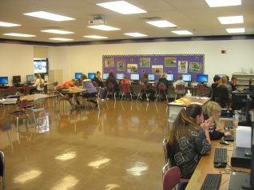
Our Guiding Principles
Any Student, Any Stage in the
Writing Process
We battle the common stigma of “the writing center is just for struggling writers.” This is for smart writers actually, because a good writer realizes that everyone can use help.
We’re so much more than a “proofreading service.”
The Student Does All the Work
Coaches support, assist, and encourage writers,
but do not actually write (unless modeling).
We use a non-directive approach.
Notes:
Marie: reads Point #1
Morgan: Adds, “Concerning the first bullet point, we actually consult with one another on our work because, as coaches, we know first-hand the value of talking about our writing with others. In addition to proofreading, we help classmates come up with topics, brainstorm, research, and outline. We’ll even help kids with tech-related issues. We’ll also serve as an audience for classmates preparing a presentation.”
Morgan: Reads Point #2
Mya: Adds “Non-directive means that, as much as possible, we don’t tell our classmates what to do. We try to ask questions that guide them to think about their writing. For example, instead of saying, ‘Put a period here,’ we might ask, ‘What’s this sentence missing?’ This way, students think through their own writing issues.”

Slide 6
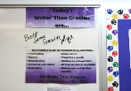
Our Guiding Principles
Transparency to Teachers,
Confidentiality for Students
Teachers receive a “session summary” following the consultation so they have an accurate account of what their students accomplished.
Students should feel safe that what happens during a coaching session stays private.
Better Writers, Not Just Better Papers
If students and tutors only focus on earning an A on the assignment at hand, they’re missing out on a valuable learning opportunity. Coaches should pass along what they know about good writing.
Notes:
Allison: Reads Point #3
Zhenya: Adds, “It’s really important that teachers get a sense of what their students accomplished during a coaching session. That way, they can see how the session helped their student and whether it was worthwhile. The teacher will also know where to pick up with the student, or whether to write another pass. We’re kind of like teachers’ minions. What a teacher can’t get to, in terms of one-to-one writing help, we can.”
Others: Hand out copies of “session summary.”
Zhenya: Reads Point #4
Allison: We get reminded over and over by Mr. Martin that as we tutor, we should be teaching, not just correcting.

Slide 7
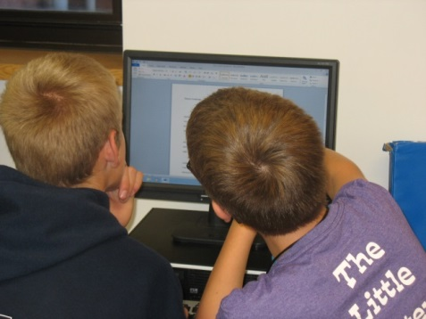
Our Guiding Principles
Training,
Training,
Training!
Notes:
Morgan: Reads slide
Mya: During our first quarter training, we cover lots of topics. For example, we discuss how to help classmates brainstorm. We also talk about how to address higher-order concerns like organization and staying on topic before we address lower-order concerns, like grammar and punctuation. As Mr. Martin tells us, don’t wax the car if the engine won’t even run. We practice how to be good listeners and how to play “devil’s advocate” without being mean. We also practice proofreading strategies, like having classmates read their work aloud to find their own errors.
Zhenya: We also talk about how to handle sticky situations, like when we think a classmate is plagiarizing. On one hand, we don’t want to rat on the student, but on the other hand, students need to know that copy and paste won’t work. So, we give them tips on avoiding plagiarism, like how to properly cite sources. Also, we’ve been instructed to tell any copy/pasters that we won’t tell on them, but that’s because we won’t have too. The teacher will easily spot it.
Allison: During training, we create a coach’s binder. In it, there are, for example, different introduction and conclusion strategies, a list of transitions, sample outlining sheet, and basic coaching procedures. We keep our binders on hand while coaching in case we need them. We’ll pass it around so you can take a look.
Coaches: Anything else we’ve learned from training?

Slide 8
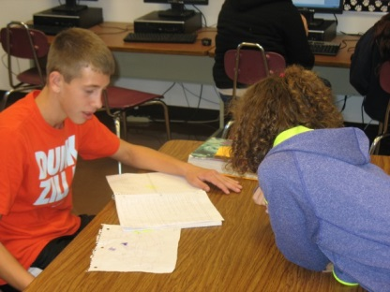
Why You Should Host a Student-staffed Writing Center at Your School
Support for Students
Collaboration and conversation are key
elements of the writing process.
It provides opportunities to test ideas and expression on a peer.
It’s an informal, fun resource for any stage in the writing process.
Notes:
Morgan: Reads Point #1
Mr. Martin: Adds, “Collaboration is often the forgotten element in the writing process of students. However, it’s real-world life skill. When adults craft pieces of writing at their work, it often involves the input of co-workers. It really just makes sense for students to start to develop in school the habit of having others help them sharpen their writing.”

Slide 9
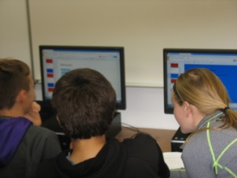
Why You Should Host a Student-staffed Writing Center at Your School
2. Support for Teachers
It’s difficult to get to every student.
Teachers outside of English may feel less comfortable teaching the “nuts and bolts.”
Support for Differentiated Instruction
It can support struggling writers and provide
enrichment for more advanced writers.
Notes:
Zhenya: reads Point #2
Mr. Martin: Adds, “by ‘nuts and bolts,’ we’re referring to issues like grammar, punctuation, and standard conventions. A social studies teacher, for example, may not want to take the class time to discuss how to properly incorporate quotations. They could, instead, give writing center referrals to the students who need it. Also, teachers often deal with over 100 students daily. To keep up with the writing of each student is
impossible. So, if a teacher knows a kid is struggling, but doesn’t have the time to get to them, they can hand out a writing center referral.”
Morgan: Reads Point #3
Mr. Martin: Adds, “It’s difficult for teachers to challenge each individual student at their own level of skill and knowledge. At least in writing, this is one way to build in differentiation. It’s Response-to-Intervention with writing, in a way. Writers at a lower skill level can receive extra instruction and one-on-one time from a peer tutor to help them improve, and writers at a higher skill level get to practice and pass on their knowledge. As the saying goes, to really learn something, you must teach it. This is true for peer tutors.”

Slide 10
Why You Should Host a Student-staffed Writing Center at Your School
4. Re-invigorating a School-wide Writing Environment
It promotes an appreciation for the value of writing across the subjects and among all students and staff.
Teachers are reminded and encouraged
to incorporate writing in their classrooms.
Students are more conscientious about reviewing their writing.
https://youtu.be/HrVDyJKJcN8
Notes:
Allison Reads Point #4
Mr. Martin: Adds, “At our junior high, we’ve seen the amount of writing that students are assigned increase, in part because teachers are reminded just by the presence of our writing center to try to incorporate writing into their instruction. In terms of students, we’ve seen our number of consultations increase, because more and more students are finding out that working with a Writin’ Titan coach is helpful. The first year, we logged about about 350 consultations, the second, about 450, and last year it was just over 550. I think the coolest thing that we’ve seen over time is that having a writing center has changed the way students write to some extent. Generally, students are more conscientious about checking their work and and more open to their peers for help. So, it’s definitely impacted how much we write and the manner in which we write.

Slide 11
Lessons Learned
Educate your staff and students as to what the purpose of your writing center is and how it works. Provide ten times the information you think should be sufficient.
Advertise, Advertise, Advertise (advertise).
3. Train your coaches in tutoring basics and writing
center principles, but also prepare them to be
flexible in their methods.
Prepared tutors to be brave and “mean.”
Be patient--it may take a while for students and
teachers to buy into the idea of a writing center.
Notes:
Presented by Mr. Martin

Slide 12
Resources to Help You Create a Writing Center at Your School www.writintitans.weebly.com
Notes:
Mr. Martin shows off website.

Slide 13
Works Cited
Kent, Richard. A Guide to Creating Student-Staffed Writing Centers:
Grades 6-12. New York: Peter Lang, 2006. Print.
McKinney, Jackie Grutsch. Peripheral Visions for Writing Centers. Logan, UT: Utah State, 2013. Print.
Suggested Readings:
Farrell, Pamela B. The High School Writing Center: Establishing and
Maintaining One. Urbana, IL; NCTE, 1989. Print.
Fels, Dawn and Jennifer Wells. The Successful High School Writing Center:
Building the Best Program for Your School. New York: Teacher’s College, 2011. Print.
Notes:
Mr. Martin

Slide 14
Contact—
Rich Martin—
martinr@unit11.org
Notes:
Mr. Martin concludes.

